Slide 1
ACTIVITY RECOGNITION IN SMART HOME ENVIRONMENTS USING CRF AND HMM
CS 284 Mini Project Presentation by Inna Calimbahin and Isabelle Tingzon
Ordonez, et al. Activity recognition using hybrid generative/discriminative models on home environments using binary sensors.
Kasteren, T. L. M. Activity recognition for health monitoring elderly using temporal probabilistic models.

Slide 2

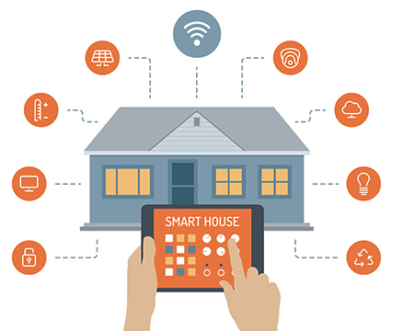
ACTIVITY RECOGNITION FOR HEALTH MONITORING
Activities of daily living (ADLs) are good indicators of elderly health status.
Smart home environments are capable of monitoring activities performed by its inhabitants.
Activity Recognition is a key component in automated health monitoring.

Slide 3
In our study, we use CRFs and HMMs for activity recognition of ADLs in smart home environments.
Their performances are then compared with other classifiers i.e. SVM, Decision Trees, and Gaussian Naive Bayes classifier.

Slide 4

SENSOR DATASET
Source: University of California - Irvine (UCI) Machine Learning Repository
Sensor data is composed of temporal data generated by a set of binary sensors installed in a home environment.
Datasets are comprised of the ADLs performed by two different users (one dataset per user) in their respective homes for a certain number of days
Fig 1. Home Settings Description

Slide 5
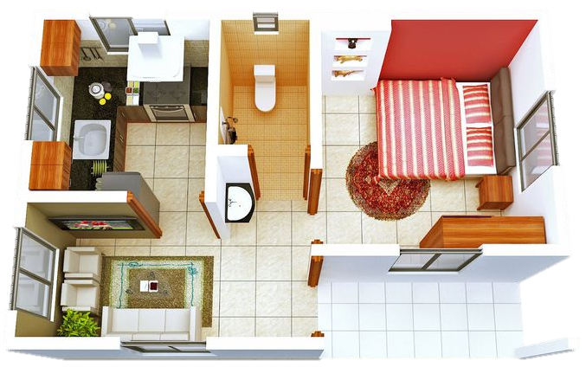
TYPES OF SENSORS: OrdonezA
Pressure: (1) Bed, (2) Seat
PIR: (3) Shower, (4) Basin, (5) Cooktop
Magnetic: (6) Main door, (7) Fridge, (8) Cabinet, (9) Cupboard
Flush: (10) Toilet
Electric: (11) Microwave, (12) Toaster
10
5
3
1
9
8
7
4
2
6

Slide 6
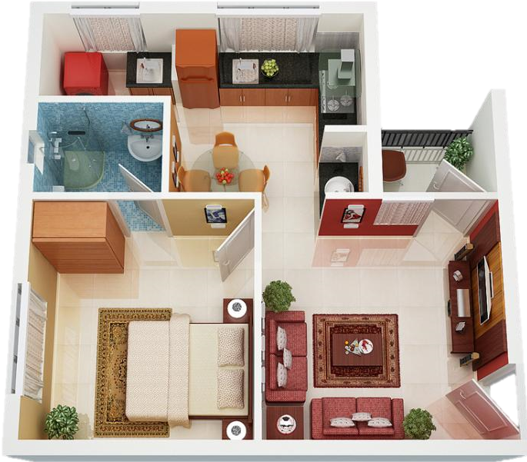
TYPES OF SENSORS: OrdonezB
Pressure: (1) Bed, (2) Seat
PIR: (3) Shower, (4) Basin, (5) Door Kitchen, (6) Door Living, (7) Door Bedroom
Magnetic: (8) Main door, (9) Fridge, (10) Cupboard
Flush: (11) Toilet
Electric: (12) Microwave
9
4
10
3
5
8
7
6
2
1

Slide 7
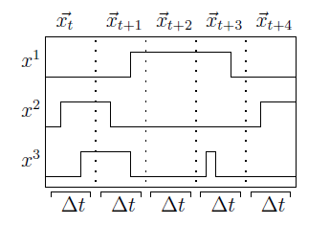
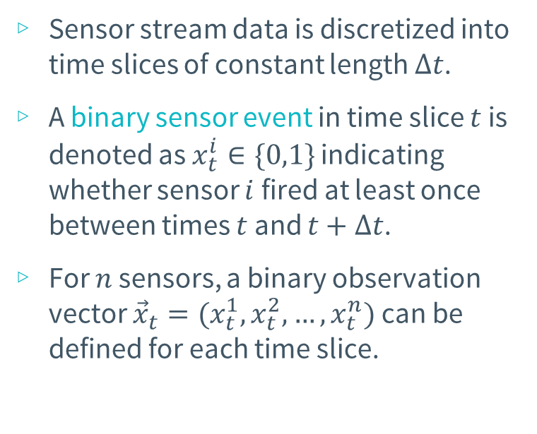
SENSOR STREAM DISCRETIZATION
Sensor stream data is discretized into time slices of constant length $Δt$.
A binary sensor event in time slice $t$ is denoted as $x_{t}^{i}∈\{0,1\}$ indicating whether sensor $i$ fired at least once between times $t$ and $t+Δt$.
For $n$ sensors, a binary observation vector ${\vec{x}}_{t}=(x_{t}^{1}, x_{t}^{2}, …, x_{t}^{n})$ can be defined for each time slice.
Fig 2. Temporal segmentation

Slide 8
SENSOR DATA: DAY AND TIME
Apart from the actual sensor events, the time of day and day of the week that the events occur are also considered valuable features.
Time of Day - values are binned into the following hour ranges:
0-5 (early morning), 5-10 (morning), 10-15 (afternoon), 15-20 (evening), 20-24 (late evening)
Day of the week – can be represented by a unique identifier

Slide 9
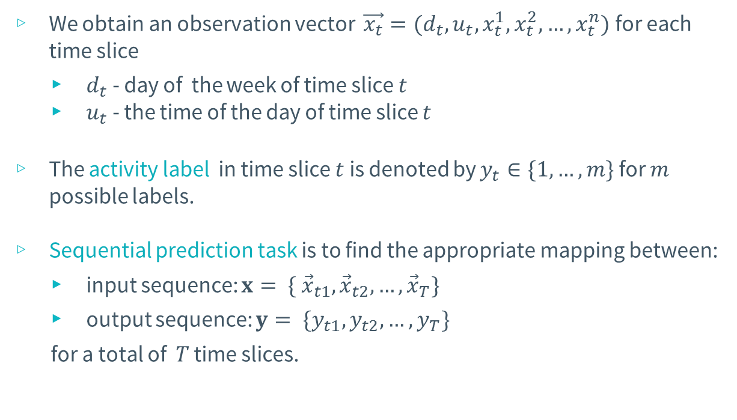
SEQUENTIAL PREDICTION TASK
We obtain an observation vector $\vec{x_{t}}=(d_{t}, u_{t}, x_{t}^{1}, x_{t}^{2}, …, x_{t}^{n})$ for each time slice
$d_{t}$ - day of the week of time slice $t$
$u_{t}$ - the time of the day of time slice $t$
The activity label in time slice $t$ is denoted by $y_{t}∈\{1, …, m\}$ for $m$ possible labels.
Sequential prediction task is to find the appropriate mapping between:
input sequence: $x= \{ {\vec{x}}_{t1},{\vec{x}}_{t2}, …,{\vec{x}}_{T}\}$
output sequence: $y= \{y_{t1}, y_{t2}, …, y_{T}\}$
for a total of $T$ time slices.

Slide 10
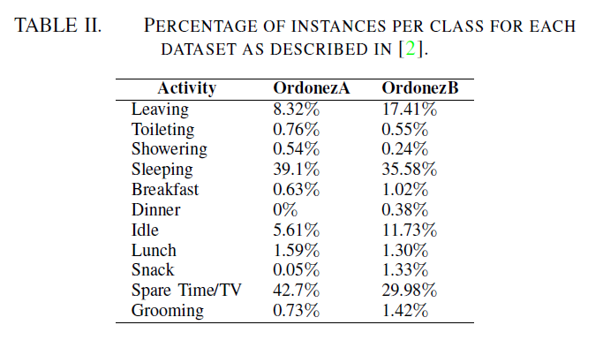
ACTIVITY LABELS

Slide 11
ACTIVITY LABELS
← Unlabelled data
(anomaly in the dataset)

Slide 12
Date | Time | Sensor |  |  |  | Activity Label
 |  | Seat | Main Door | Fridge | …
2011-11-29 | 19:01:59 | 0 | 1 | 0 | … | Leaving
2011-11-29 | 19:02:59 | 0 | 0 | 0 | … | Leaving
… | … | … | … | … | … | …
2011-11-29 | 20:20:59 | 0 | 0 | 0 | … | Leaving
2011-11-29 | 20:21:59 | 0 | 1 | 0 | … | Leaving
2011-11-29 | 20:22:59 | 0 | 0 | 0 | … | ?
2011-11-29 | 20:23:59 | 0 | 0 | 0 | … | ?
2011-11-29 | 20:24:59 | 1 | 0 | 0 | … | Spare Time/TV
2011-11-29 | 20:25:59 | 1 | 0 | 0 | … | Spare Time/TV
2011-11-29 | 20:26:59 | 1 | 0 | 1 | … | Snack

Slide 13
Date | Time | Sensor |  |  |  | Activity Label
 |  | Seat | Main Door | Fridge | …
2011-11-29 | 19:01:59 | 0 | 1 | 0 | … | Leaving
2011-11-29 | 19:02:59 | 0 | 0 | 0 | … | Leaving
… | … | … | … | … | … | …
2011-11-29 | 20:20:59 | 0 | 0 | 0 | … | Leaving
2011-11-29 | 20:21:59 | 0 | 1 | 0 | … | Leaving
2011-11-29 | 20:22:59 | 0 | 0 | 0 | … | Idle
2011-11-29 | 20:23:59 | 0 | 0 | 0 | … | Idle
2011-11-29 | 20:24:59 | 1 | 0 | 0 | … | Spare Time/TV
2011-11-29 | 20:25:59 | 1 | 0 | 0 | … | Spare Time/TV
2011-11-29 | 20:26:59 | 1 | 0 | 1 | … | Snack

Slide 14
Date | Time | Sensor |  |  |  | Activity Label
 |  | Seat | Main Door | Fridge | …
2011-11-29 | 19:01:59 | 0 | 1 | 0 | … | Leaving
2011-11-29 | 19:02:59 | 0 | 0 | 0 | … | Leaving
… | … | … | … | … | … | …
2011-11-29 | 20:20:59 | 0 | 0 | 0 | … | Leaving
2011-11-29 | 20:21:59 | 0 | 1 | 0 | … | Leaving
Remove unlabelled data
2011-11-29 | 20:24:59 | 1 | 0 | 0 | … | Spare Time/TV
2011-11-29 | 20:25:59 | 1 | 0 | 0 | … | Spare Time/TV
2011-11-29 | 20:26:59 | 1 | 0 | 1 | … | Snack

Slide 15
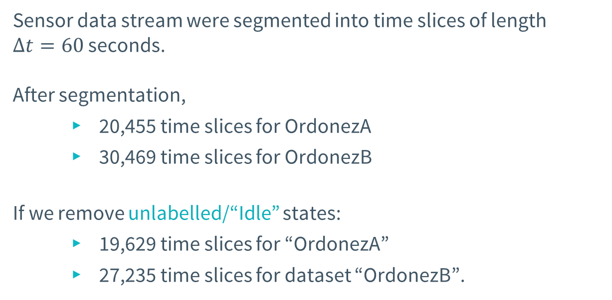
EXPERIMENTAL SETUP
Sensor data stream were segmented into time slices of length $Δt=60$ seconds.
After segmentation,
20,455 time slices for OrdonezA
30,469 time slices for OrdonezB
If we remove unlabelled/“Idle” states:
19,629 time slices for “OrdonezA”
27,235 time slices for dataset “OrdonezB”.

Slide 16
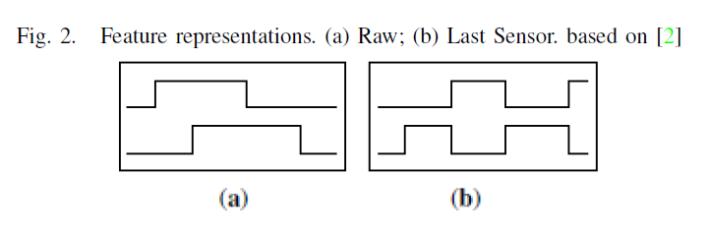
FEATURE REPRESENTATION
Raw sensor representation -produces sensor data as it was received from the WSN, i.e. value is 1 if sensor is active, else 0.
Last sensor representation – indicates which sensor fired last.
The sensor that changed its state last continues to produce a 1 and only changes to 0 when another sensor changes its state to 1.

Slide 17
RAW SENSOR REPRESENTATION
Date | Time | Sensor |  |  |  | Activity Label
 |  | Seat | Main Door | Fridge | …
2011-11-29 | 19:01:59 | 0 | 1 | 0 | … | Leaving
2011-11-29 | 19:02:59 | 0 | 0 | 0 | … | Leaving
… | … | … | … | … | … | …
2011-11-29 | 20:20:59 | 0 | 0 | 0 | … | Leaving
2011-11-29 | 20:21:59 | 0 | 1 | 0 | … | Leaving
2011-11-29 | 20:22:59 | 1 | 0 | 0 | … | Spare Time/TV
2011-11-29 | 20:23:59 | 1 | 0 | 0 | … | Spare Time/TV
2011-11-29 | 20:24:59 | 1 | 0 | 1 | … | Snack

Slide 18
LAST SENSOR REPRESENTATION
Date | Time | Sensor |  |  |  | Activity Label
 |  | Seat | Main Door | Fridge | …
2011-11-29 | 19:01:59 | 0 | 1 | 0 | … | Leaving
2011-11-29 | 19:02:59 | 0 | 1 | 0 | … | Leaving
… | … | … | … | … | … | …
2011-11-29 | 20:20:59 | 0 | 1 | 0 | … | Leaving
2011-11-29 | 20:21:59 | 0 | 1 | 0 | … | Leaving
2011-11-29 | 20:22:59 | 1 | 0 | 0 | … | Spare Time/TV
2011-11-29 | 20:23:59 | 1 | 0 | 0 | … | Spare Time/TV
2011-11-29 | 20:24:59 | 0 | 0 | 1 | … | Snack

Slide 19
LIBRARIES/TOOLBOXES
CRF++ by Tako Kudo (2005)
Scikit-learn: Machine Learning in Python, Pedregosa et al. (2011)
SVM, Decision Trees, Naïve Bayes
Matlab’s HMM tool under the Statistics and Machine Learning Toolbox
Training: Baum-Welch algorithm to estimate the transition and observation probabilities
Testing: Viterbi algorithm to compute for the most likely sequence of states the model would go through to generate a given sequence of observations

Slide 20
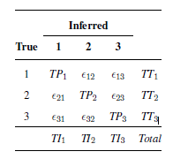
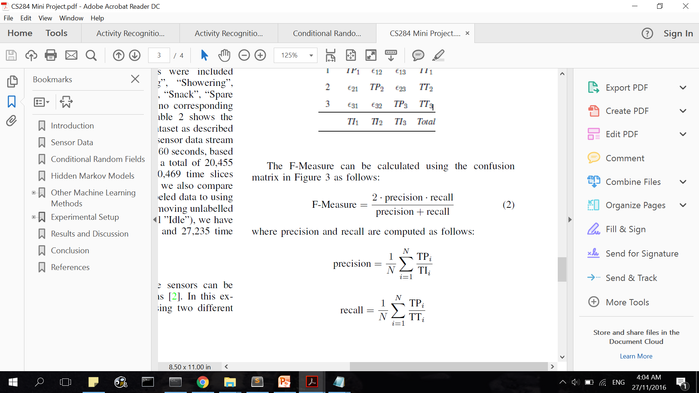
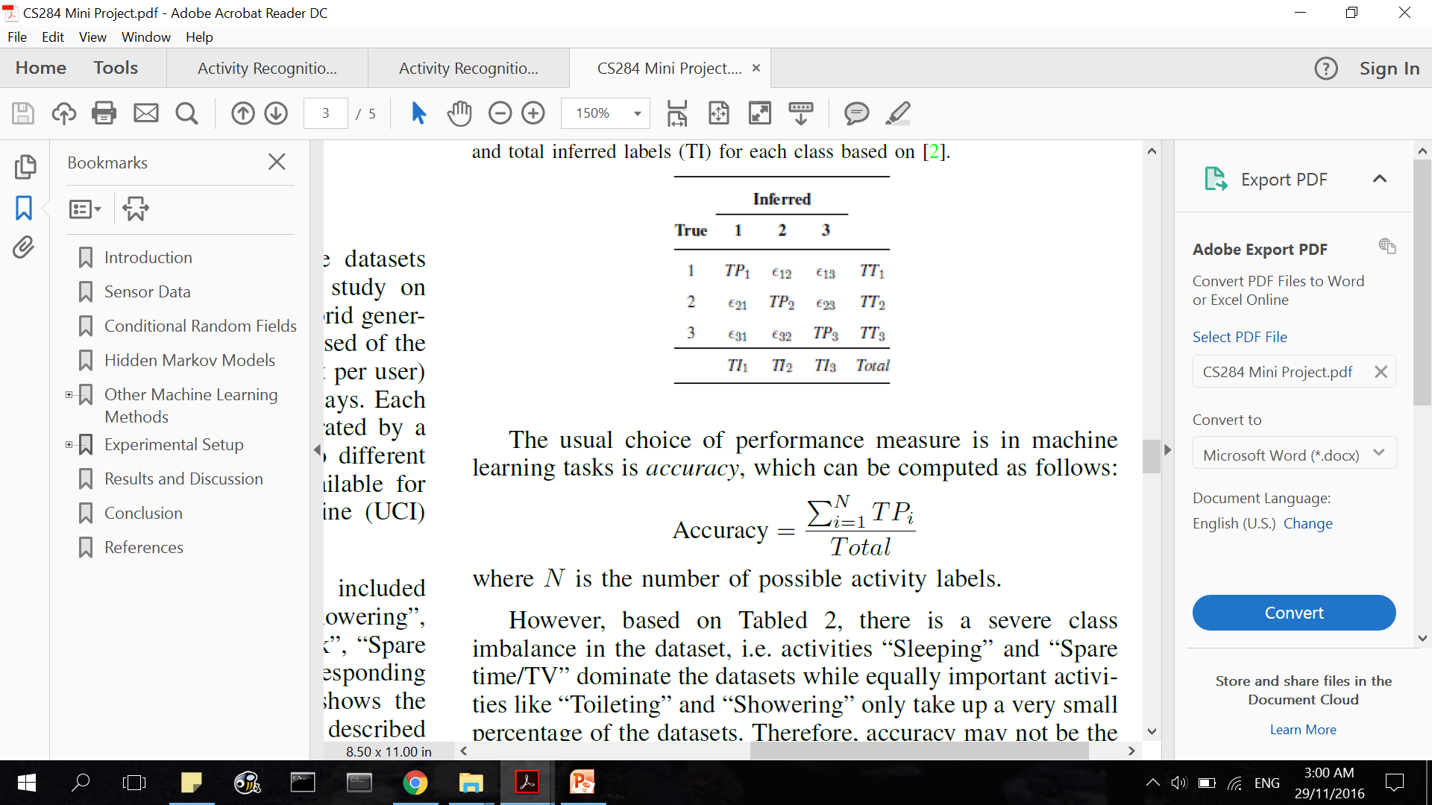
PERFORMANCE MEASURE: F-MEASURE
nature of the dataset → severe class imbalance
Accuracy may not be a suitable performance measure.
F-Measure considers correct classification of each class as equally important.

Slide 21
VALIDATION
Leave-one-day-out approach
takes one full day of sensor readings as the test set and uses the remaining sensor readings as the training set.
process is repeated for all the days and reports the average F-Measure over the total number of days
OrdonezA – 14 days
OrdonezB – 21 days

Slide 22
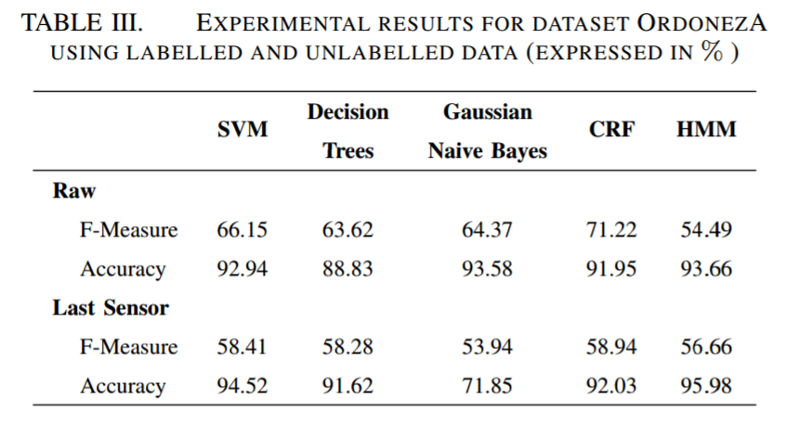
RESULTS (ORDONEZA)

Slide 23
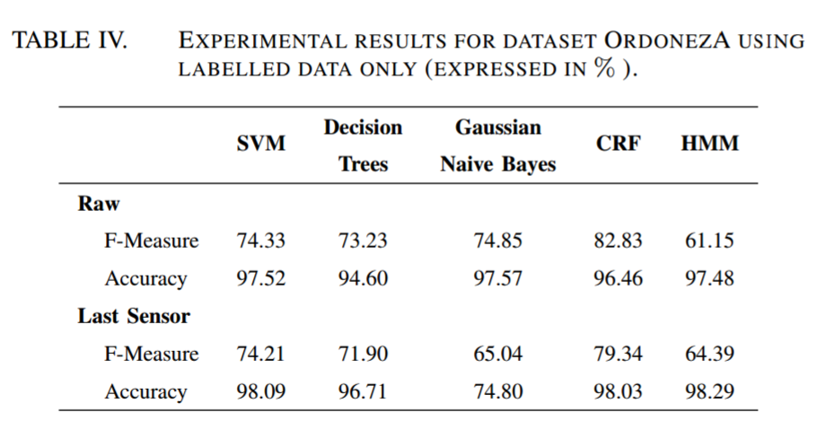
RESULTS (ORDONEZA)

Slide 24
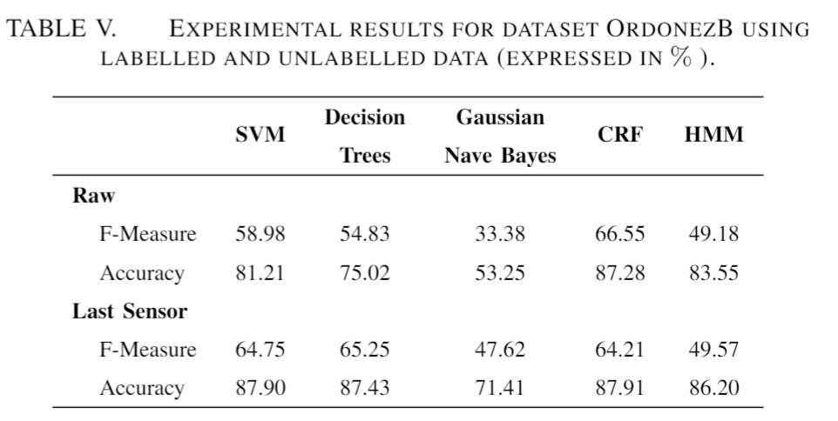
RESULTS (ORDONEZB)

Slide 25
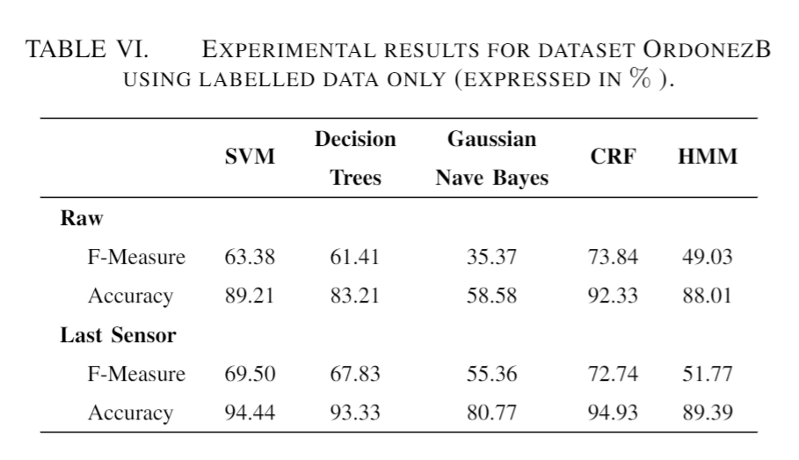
RESULTS (ORDONEZB)

Slide 26
CONCLUSION
Overall, CRFs outperform the other machine learning methods for both datasets “OrdonezA” and “OrdonezB”
the highest F-Measure being 82.83% for “OrdonezA” and 73.84% for “OrdonezB”
Higher performance measures are achieved for datasets with only labelled data than datasets with unlabelled data.
We conclude that among the machine learning methods used, CRFs are the most effective in classifying ADLs based on binary sensor data stream.

Slide 27
References
[1] UCI Machine Learning Repository: Activities of Daily Living (ADLs) Recognition Using Binary Sensors Data Set. Avaliable Online: https://archive.ics.uci.edu/ml/machine-learning-databases/00271/ Accessed: 24 Nov. 2016.
[2] Ordonez, Fco Javier, Paula de Toledo, and Araceli Sanchis. ”Activity recognition using hybrid generative/discriminative models on home environments using binary sensors.” Sensors 13.5 (2013): 5460-5477.
[3] Nazerfard, Ehsan, et al. ”Conditional random fields for activity recognition in smart environments.” Proceedings of the 1st ACM International Health Informatics Symposium. ACM, 2010.
[4] Lafferty, John, Andrew McCallum, and Fernando Pereira. ”Conditional random fields: Probabilistic models for segmenting and labeling sequence data.” Proceedings of the Eighteenth International Conference on Machine Learning, ICML. Vol. 1. 2001.
[5] Corinna Cortes and Vladimir Vapnik. Support-vector networks. Machine learning, 20(3):273297, 1995.
[6] Mohamed Aly. Survey on multiclass classification methods. 2005.
[7] Leo Breiman, Jerome Friedman, Charles J Stone, and Richard A Olshen. Classification and regression trees. CRC press, 1984.
[8] Kasteren, T. L. M. ”Activity recognition for health monitoring elderly using temporal probabilistic models.” (2011).

Slide 28
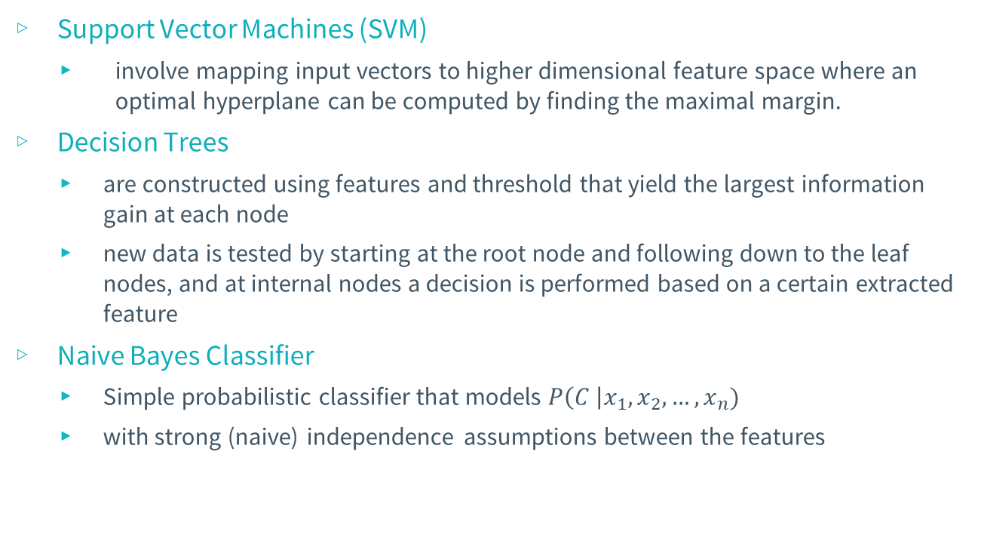
Other Machine Learning Techniques
Support Vector Machines (SVM)
involve mapping input vectors to higher dimensional feature space where an optimal hyperplane can be computed by finding the maximal margin.
Decision Trees
are constructed using features and threshold that yield the largest information gain at each node
new data is tested by starting at the root node and following down to the leaf nodes, and at internal nodes a decision is performed based on a certain extracted feature
Naive Bayes Classifier
Simple probabilistic classifier that models $P\left(C \right|x_{1}, x_{2}, …, x_{n})$
with strong (naive) independence assumptions between the features

